Slide 1
HDSC’22 PREMIER PROJECT PRESENTATION:
By Team Cart ( PP22/H602 )
Presenters: Nasir Ibrahim and Jimoh Rildwan

Slide 2
OBJECTIVE:
To discover the degree of correlation between CMS star rating and patient satisfaction.

Slide 3
INTRODUCTION TO DATASET
Data on over 4000 hospitals in the US from 2016 to 2020 was provided by Hospital Compare.
Patients were required to fill a 55-question survey. Each question in the survey answered by a patient for a hospital corresponds to a row in the dataset.
Features | Type | Description
Hospital Overall Rating | Char(13) | Hospital Overall Star Rating 1=Worst; 5=Best. Aggregate measure of all other measures
Patient Survey Star Rating | Char(14) | Overall rating for survey item
HCAHPS Question | Char(138) | HCAHPS Patient Survey Question

Slide 4
DATA TRANSFORMATION
The patient’s responses to the HCAHPS questions were used to calculate the HCAHPS linear mean value, which were in turn used to generate 10 star ratings, these 10 star ratings were averaged to obtain a summary star rating.
Each of these star ratings, their linear mean scores and the summary star rating were extracted from the dataset in such a way that each hospital now had only one row per year.
Communication with Nurses
Communication with Doctors
Responsiveness of Hospital Staff
Communication about Medicines Discharge Information
Care Transition
Cleanliness of Hospital Environment
Quietness of Hospital Environment Hospital Rating
Recommend the Hospital

Slide 5
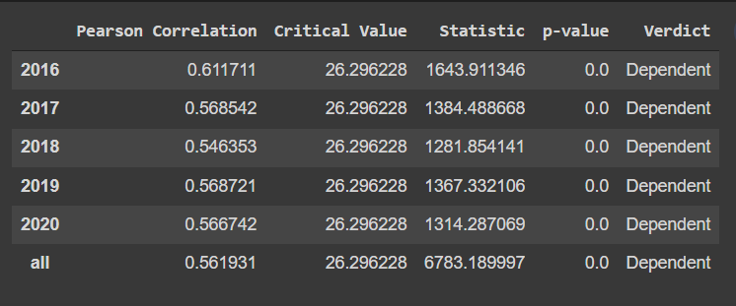
STATISTICAL TESTING:
Hypothesis: There is no significant relationship between both variables, they are independent of each other.
Test: If p-value is less than 0.05, reject hypothesis and declare both variables to be dependent but if p-value is greater than 0.05 accept hypothesis and declare both variables to be independent.
Result: Analysis of the summary star rating and the hospital overall rating resulted in a p-value of 0.0, therefore both variables can be said to have significant relationship.
The correlation between both variables, about 0.56, also indicates a significant positive relationship.

Slide 6
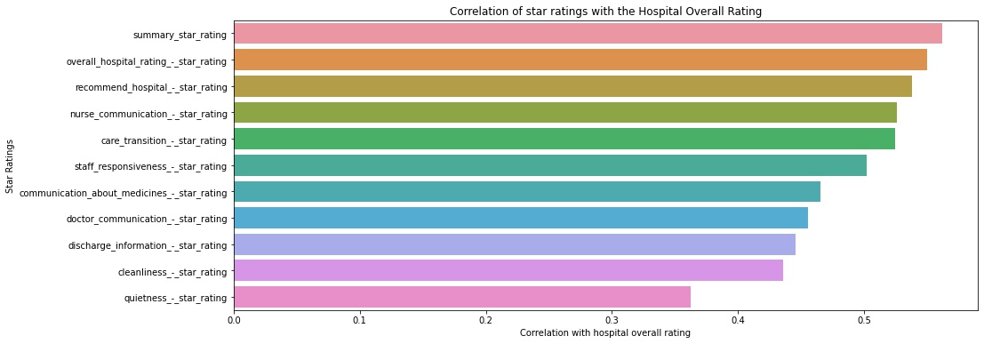
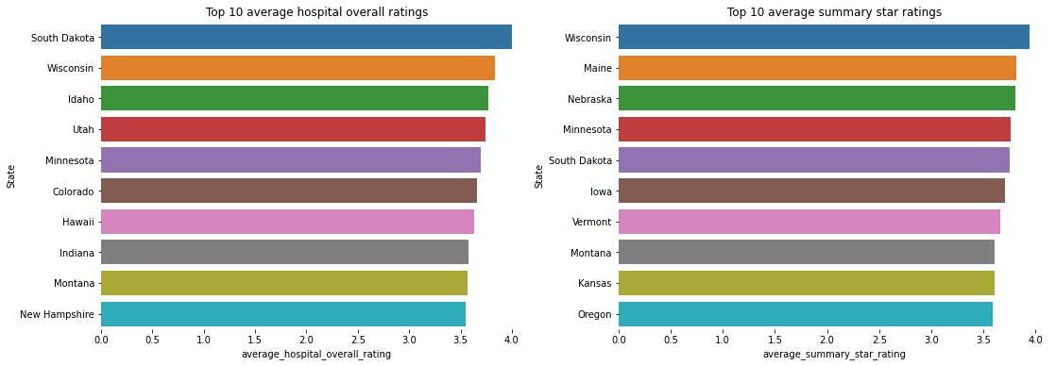
VISUALIZATION

Slide 7
MODELLING
A Ridge regression analysis was carried out to obtain the importance of the features.
The dependent variable or target is the hospital overall rating.
Data preprocessing steps carried out include:
Encoding categorical features with numerical values.
Dropping of rows where hospital overall rating value is missing is to be dropped.
The data is to be split randomly, using the sklearn_model_selection.train_test_split with a random state value of 0, 70% for training and 30% for testing.
The performance of the model was evaluated using the Coefficient of determination (R-squared score).

Slide 8
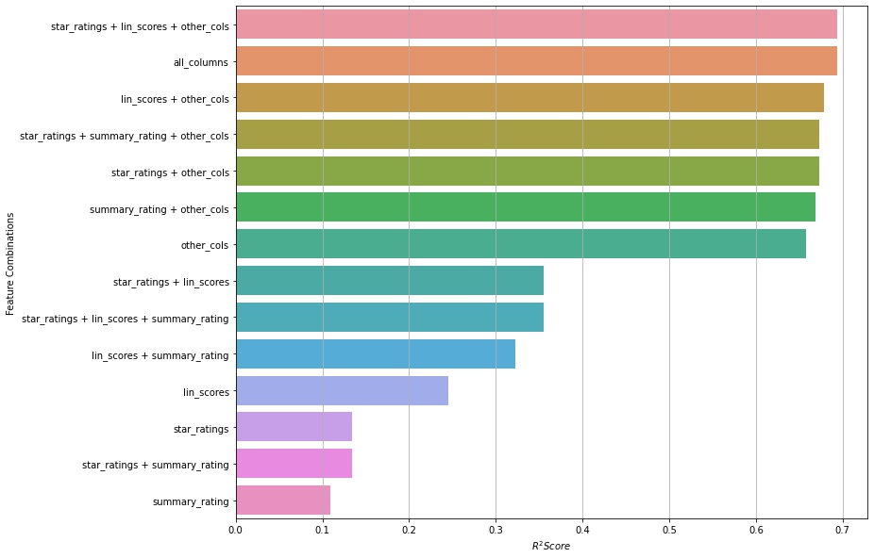
MODELLING
The best result was gotten from the use of all the available columns.
The columns that were of high importance weren't the ratings and scores columns but the other columns which consisted of national comparisons and the others.
The Linear scores columns showed highest importance amongst the rating and scores columns.
The summary star rating column showed the lowest importance when used stand alone.

Slide 9
CONCLUSION
The correlation statistical testing we found the star ratings to be highly significantly correlated with the Hospital overall rating.
Using a Ridge regression model, it was observed that the summary star rating is not very significant in predicting the hospital overall rating

Slide 10
THANK YOU FOR LISTENING

